Slide 1

#CollabDays
From Experimentation
to Impact
Making AI Work in the Real World
Simon Owen • Al Eardley
Notes:
[Sources]
Session title, abstract and learning outcomes supplied by Simon Owen in the conversation.
Visual on this slide was generated with Microsoft Copilot.
[/Sources]

Slide 2












#CollabDays
Made possible by our sponsors
GOLD
SILVER
COMMUNITY
Thank you for supporting a free community event at The National Museum of Computing.

Slide 3

OUR OWN EXPERIMENTATION TO IMPACT
EXPERIMENT
We're recording video of ourselves (the presenters only) and capturing the session audio to explore what value can be created from the content afterwards.
If you'd like to ask a question, we'll be passing a microphone around the room so we can capture them clearly.
Prefer not to be recorded?
No problem at all. Please feel free to catch Simon or Al after the session, or at any point during the day, and we'll be happy to continue the conversation off-mic.
Thank you for helping us learn what works and what doesn't.
Notes:
Structure the session around why organisations get stuck between enthusiasm and value, not around technology.

Slide 4
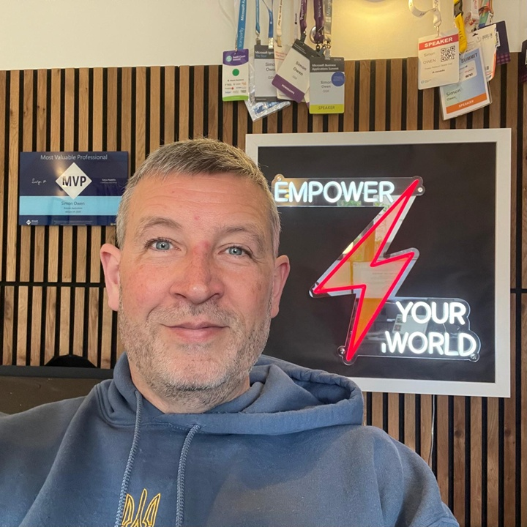

Two perspectives. One shared problem.
Simon Owen
Al Eardley
Empower Your World
Microsoft Innovation Hub
Notes:
Hi, I'm Simon Owen. By day I work for Capgemini. By night I've been building Empower Your World.
What started as a simple blog exploring the impact of AI has grown into a much bigger quest: understanding how people and organisations can build the capability they need to thrive in an AI-enabled world.

Slide 5
This is the gap we want to explore
Why promising AI experiments so often fail to become deployed, adopted and trusted ways of working that deliver measurable value.
ORGANISATION
PROCESS
INDIVIDUAL
Foundations for scale
A route from idea to value
Confidence, capability and trust
We will alternate between these challenges and the practical work each of us is doing to close the gap.
Notes:
[Sources]
Session title, abstract and learning outcomes supplied by Simon Owen in the conversation.
[/Sources]

Slide 6
WHAT KEEPS APPEARING
Eight recurring challenges
01
02
03
04
The expectation trap
Experimentation to capability
AI literacy, not prompt literacy
Trust is the scaling challenge
05
06
07
08
Governance that enables
Productivity to transformation
Value needs measurement
People, not technology
Notes:
Structure the session around why organisations get stuck between enthusiasm and value, not around technology.

Slide 7

CHALLENGE 01
Experimentation creates possibilities.
It does not create impact.
The organisation discovers that ideas are plentiful, but a route to value is not.
Notes:
[Sources]
Session title, abstract and learning outcomes supplied by Simon Owen in the conversation.
Visual on this slide was generated with Microsoft Copilot.
[/Sources]
The Prototype Trap

Slide 8
CHALLENGE 01
The expectation trap
Most organisations can build a proof of concept. Very few can operationalise one.
Why pilots pass
What production adds
The pattern we see
They prove possibility, not value — and they run in protected conditions.
Complexity, ownership and integration that experimentation never had to solve.
Compelling ideas with no owner, no process and no route to deployment.
The question is not “Can we build it?” It is “Can the organisation absorb it?”
Notes:
Observed repeatedly: agent concepts that demonstrate capability but lack ownership; innovation challenge ideas disconnected from operational processes; early use cases with no route to deployment; isolated successes scaled without enabling foundations. Technical success often masks organisational unreadiness — teams measure whether something works rather than whether it changes outcomes.

Slide 9
CHALLENGE 01
The language we use is important
Four different jobs, four different bars for success. Most disappointment comes from judging one as if it were another.
PROOF OF CONCEPT
PROTOTYPE
MVP (Pilot 0)
PILOT
PURPOSE
PURPOSE
PURPOSE
PURPOSE
Does this specific technical idea work at all, in principle?
Explore the experience and shape the design with real users.
Put the smallest genuinely useful version into real users' hands.
Prove the solution works in a real business setting at limited scale.
MEASURED BY
MEASURED BY
MEASURED BY
MEASURED BY
A yes/no feasibility verdict. Technical risk retired, not value proven.
Qualitative feedback: usability, desirability and clarity of the idea.
Adoption, retention and the first honest signals of value in live use.
Business outcomes, cost to serve and readiness to scale beyond the pilot group.
ROBUSTNESS NEEDED
ROBUSTNESS NEEDED
ROBUSTNESS NEEDED
ROBUSTNESS NEEDED
Throwaway code, one happy path. No security, scale or support expectations.
Disposable front end. Data and logic can be faked, stubbed or hard coded.
Production grade for a narrow slice: secure, supported, monitored, maintainable.
Full production controls: governance, integration, support model and rollback.

Slide 10
How should we innovate?
Operationalised Platforms
Route to Live
Experimentation
Ideation
Scale
Human ambition
What if … ?
Roll-out
Problems to solve
New technology
Adoption
Fail fast
Support

Slide 11
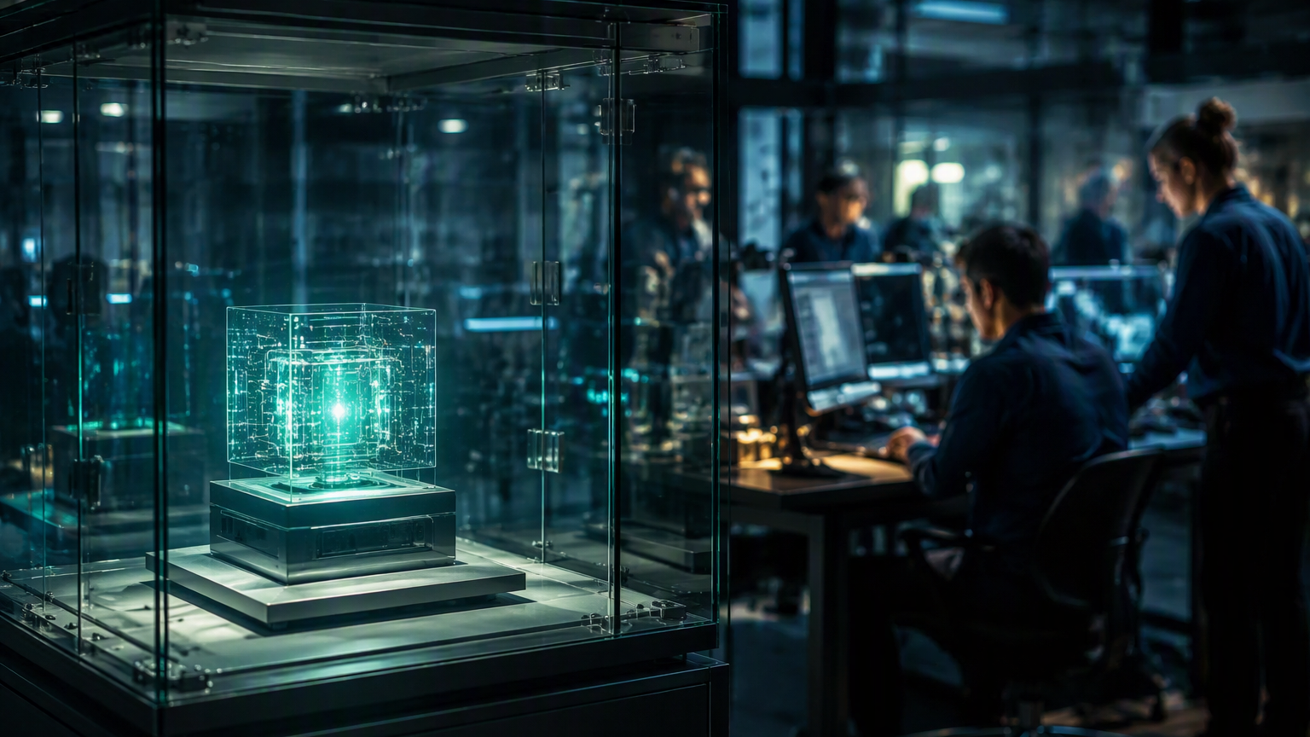
CHALLENGE 02
A proof of concept proves the idea.
It does not prove the organisation.
Production exposes the foundations that experimentation was able to avoid.
Notes:
[Sources]
Session title, abstract and learning outcomes supplied by Simon Owen in the conversation.
Visual on this slide was generated with Microsoft Copilot.
[/Sources]

Slide 12
CHALLENGE 02
It’s a journey, not a switch
What is a Frontier organisation?
How do we manage data and content?
How do we develop organisational Capabilities?
How do we ideate?
How do we experiment?
How do we govern?
How do we secure?
How do we test?
How do we build?
How do we deploy?
How do we operate?
How do we manage costs?
How do we scale?
How do we adopt?
How do we measure impact?
How do we evolve our workforce?

Slide 13
CHALLENGE 02
From experimentation to capability
The organisations succeeding with AI are building repeatable capabilities, not isolated projects.
AI strategy
Governance
Adoption
Skills development
Innovation frameworks
Delivery methods
Operating models
Value measurement
Maturity does not come from a collection of successful pilots. It comes from institutionalising the ability to repeatedly identify, develop, deploy and improve AI solutions.
The goal is not to deliver an AI project. It is to build an AI-capable organisation.
Notes:
These capabilities recur across engagements: strategy, governance, adoption, skills, innovation frameworks, delivery methods, operating models and value measurement.

Slide 14
CHALLENGE 02
How is work owned?
Project management
Product ownership
Capability ownership
OWNS
OWNS
OWNS
A defined scope, delivered once
The value a product creates for its users
An organisational ability: people, process, data, tooling
LIFESPAN
LIFESPAN
LIFESPAN
Temporary - ends at handover
Continuous - lasts as long as the product
Enduring - outlives any single product or project
QUESTION
QUESTION
QUESTION
Are we on time, on budget, in scope?
Are we solving the right problem, well?
Can we do this repeatably, safely, at scale?
FOCUS
FOCUS
FOCUS
Plan, milestones, risks, dependencies, resources
Vision, roadmap, backlog, adoption, feedback
Skills, platforms, standards, governance, reuse
SUCCEEDS WHEN
SUCCEEDS WHEN
SUCCEEDS WHEN
The agreed output is delivered and accepted
Outcomes and usage improve release on release
Many teams deliver faster because the capability exists
Projects deliver change, products deliver value, capabilities deliver the ability to do both again and again.

Slide 15

CHALLENGE 03
Prompting is not the same as
building capability.
Real change begins when people learn to think, experiment and innovate with AI.
Notes:
[Sources]
Session title, abstract and learning outcomes supplied by Simon Owen in the conversation.
Visual on this slide was generated with Microsoft Copilot.
[/Sources]

Slide 16
CHALLENGE 03
AI literacy, not prompt literacy
The first wave of AI focused on prompts. The next wave focuses on thinking.
What prompt should I use?
What problem am I trying to solve?
How do I get an answer?
How do I know the answer is useful?
Taught today
Prompt engineering · Tool usage · Product features
Rarely taught
Critical thinking · Evaluation · Experimentation · Human judgement
Capability emerges when people learn to think alongside AI, not simply operate it.
Notes:
Move the organisation from tool operation to AI-assisted problem solving: critical thinking, evaluation, experimentation and human judgement.

Slide 17

CHALLENGE 04
People adopt what they trust.
They quietly avoid what they do not.
Trust, not technical capability, decides whether a solution ever scales.

Slide 18
CHALLENGE 04
Trust is the real scaling challenge
The biggest barrier to scale is rarely technical. It is confidence.
Heard repeatedly
Trust comes from
Can I trust the output?
Can I explain it?
Will it expose risk?
What if it is wrong?
Who is accountable?
Transparency
Governance
Feedback loops
Human oversight
Clear operating boundaries
Trust enables adoption. Fear prevents scale.
Notes:
Successful organisations focus on creating confidence in the process rather than certainty in the answer.

Slide 19

CHALLENGE 05
Governance is not the brake.
It is what makes speed safe.
Clear guardrails let teams move faster, because fewer decisions need escalating.

Slide 20
CHALLENGE 05
Governance must enable innovation
One of the most recurring tensions is the perceived choice between innovation and control.
Clear guardrails
Clear ownership
Legitimate concerns
Data security
Compliance
Privacy
Risk
Regulatory obligations
Clear policies
Clear escalation routes
The challenge is when governance becomes a brake instead of an accelerator.
Good governance creates the confidence to move faster.
Notes:
Clear guardrails, ownership, policies and escalation routes beat forcing every experiment through heavy governance processes.

Slide 21

CHALLENGE 06
Saving minutes is not the goal.
Changing the work is.
Productivity gains are where transformation starts, not where it finishes.

Slide 22
CHALLENGE 06
From productivity to transformation
The most mature organisations stop asking how to use AI and start asking how to redesign work.
STAGE 1
Individual productivity
STAGE 2
Team productivity
STAGE 3
Process improvement
STAGE 4
Business transformation
STAGE 5
New operating models
Copilot as an assistant · Agents performing work · Human–agent collaboration · Redesigned processes · New organisational capabilities
The greatest value is rarely doing the same work faster. It comes from doing work differently.
Notes:
The progression runs from individual productivity through team productivity, process improvement and business transformation to new operating models.
Note: an automated contrast check flags two ground-coloured words on this slide; they belong to an empty inherited layout placeholder, not to any slide content, and are not visible in presentation.

Slide 23

CHALLENGE 07
Trust and measurable value
have to be earned in use.
Confidence grows through evidence, feedback, transparency and visible outcomes.
Notes:
[Sources]
Session title, abstract and learning outcomes supplied by Simon Owen in the conversation.
Visual on this slide was generated with Microsoft Copilot.
[/Sources]

Slide 24
CHALLENGE 07
Value realisation requires measurement
Many organisations struggle because success was never clearly defined.
Commonly measured
Rarely measured
Licences
Users
Deployments
Prompts
Time saved
Process improvement
Customer outcomes
Revenue impact
Risk reduction
Establish baselines, outcomes and feedback mechanisms before deployment.
If value cannot be measured, adoption becomes an act of faith.
Notes:
Define the measures before the rollout, not after it.

Slide 25

CHALLENGE 08
Deployment does not create adoption.
Technology can be released while processes, incentives and ways of working remain unchanged.
Notes:
[Sources]
Session title, abstract and learning outcomes supplied by Simon Owen in the conversation.
Visual on this slide was generated with Microsoft Copilot.
[/Sources]

Slide 26
CHALLENGE 08
Success depends on people, not technology
Most AI initiatives fail because adoption is treated as a phase rather than a capability.
Invested in heavily
Consistently underinvested
Models
Tools
Platforms
Architecture
Behavioural change
Skills
Leadership
Ways of working
Incentives
Adoption happens person by person and team by team.
Notes:
Discussion: why training alone does not create adoption; why awareness is not behavioural change; the difference between usage and meaningful usage; creating cultures where experimentation is encouraged.

Slide 27
IN SUMMARY
Five takeaways to leave with
01
02
03
04
05
Impact, not experiments
Capabilities, not projects
Right rigour, right stage
Trust decides adoption
Start where value already is
A successful pilot proves feasibility. Value only appears once the work itself changes.
Projects end. Capabilities are owned, funded and improved long after go-live.
Proof of concept, prototype, MVP and pilot answer different questions — match the robustness to the question.
People adopt what they trust and quietly avoid what they do not. Governance makes speed safe.
Pick the work with real friction, measure the change in outcomes, and scale from there.
From experimentation to impact is a change in how the work is done — not a better experiment.

Slide 28
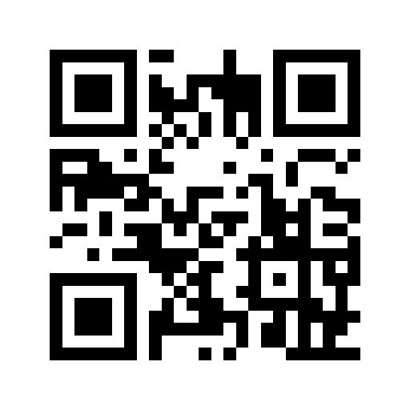
PRESS PLAY
FOR MARK
Mark Macrae co-founded SharePoint Saturday UK — the community event that became CollabDays Bletchley Park.
Scan to support Mark and his family following his brain cancer diagnosis.
SCAN TO DONATE
HELP KEEP THIS BRAIN RUNNING
givealittle.co.nz/cause/help-keep-this-brain-running

Slide 29
Thank you
From experimentation to impact takes more than a successful experiment.
Simon Owen
https://www.empoweryour.world/
Al Eardley
https://aka.ms/al-eardley
Notes:
[Sources]
Session title, abstract and learning outcomes supplied by Simon Owen in the conversation.
[/Sources]

Slide 30

NEXT STEPS
Empower your world.
Start where the value already is.
Practical ways to turn these ideas into deployed, adopted ways of working.

Slide 31
SIMON’S PERSPECTIVE
Empower Your World
Turn ambition into capability
A practical operating model for turning organisational intent into capability-building work, reusable journeys and community-supported adoption.
Data > Information > Knowledge > Wisdom
Notes:
[Sources]
Session title, abstract and learning outcomes supplied by Simon Owen in the conversation.
[/Sources]

Slide 32
The organisation says what it is trying to do.
The model turns that into work.
34 modules, five tiers
North Star
Where the organisation is heading
T0
Foundation
M01–M08
8
Transformation Motion
The move it is making — 7 of them
T1
Core Arc
M10–M15
6
Journey
The route through that move
T2
Operating Layer
M20–M27
8
Module
T3
ROI & Assurance
M30–M35
6
The capability building blocks — 34
Asset
T4
Change & Adoption
M40–M45
6
Playbooks, canvases, learning packs
Modules are the bricks. Nobody buys a brick — they buy the move they are trying to make.
Notes:
[Sources]
Session title, abstract and learning outcomes supplied by Simon Owen in the conversation.
[/Sources]

Slide 33
Worked example — J01, live on the site today
Inside a Journey
TM01
Get Started Safely → J01 Make AI Adoption Safe → 6 modules M10–M15
The capability spine
What the Journey actually gives you
M10
AI Risk
Playbooks
How to run it, step by step
M11
AI Risk Controls
Learning packs
How to understand it
M12
Living Governance
Canvases
How to do the work
M13
Evidence & Audit-Readiness
Module cards
What each brick is for
M14
Incident & Surprise Response
Release pack
One download, versioned
M15
Use-case Intake & Gates
Start Here
Honest scope, and what it is not
Same bricks, different buildings — J02 reuses M15 for a completely different outcome.
Notes:
[Sources]
Session title, abstract and learning outcomes supplied by Simon Owen in the conversation.
[/Sources]

Slide 34
You do not have to buy anything to start
Four ways in
Public
Registered
Participant
Professional
Free, no sign-up
Free, sign in
Attend a workshop
Paid / partner
The J01 pack. Read it, run it, keep it.
Deeper packs, templates, and the Slack community.
Facilitated delivery and the workshop pack.
Full library, accreditation, delivery rights.
The community is the part that makes it stick
Capability does not come from downloading a document. It comes from trying something, getting it wrong, and having somewhere to ask why.
Slack
Office hours
Case reviews
Open channel — bring a real problem
Regular, live, no agenda needed
Other people's failures, shared safely
Notes:
[Sources]
Session title, abstract and learning outcomes supplied by Simon Owen in the conversation.
[/Sources]

Slide 35
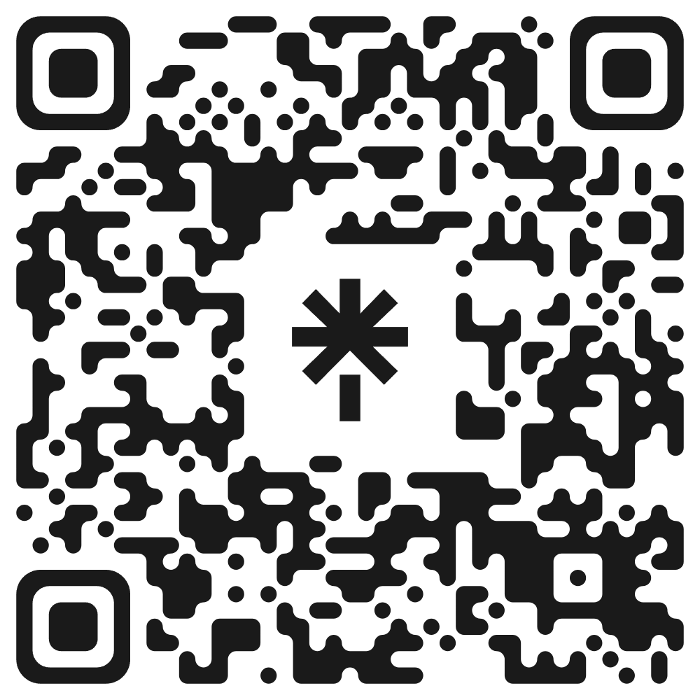
Live today — 23 September
Come and test this with me
Journey pack
J01 Make AI Adoption Safe
Free. Live from today.
Slack community
Open channel
Bring a real problem, not a polite question.
LinkedIn
Simon Owen
The Impact of AI series — all ten parts.
Linktree
Everything in one place
Blog, papers, models, events.
https://linktr.ee/SiOwenDigital
The argument is free. The community is where it gets tested.
Notes:
[Sources]
Session title, abstract and learning outcomes supplied by Simon Owen in the conversation.
[/Sources]

Slide 36
Three things to take away
01
Scaling AI is an organisational challenge
The technology is only one part of the route from idea to impact.
02
Adoption is capability, not access
People need space and support to think, experiment and change how work happens.
03
Trust grows from evidence in use
Reliable outcomes, feedback and learning turn optimism into sustainable value.
Notes:
[Sources]
Session title, abstract and learning outcomes supplied by Simon Owen in the conversation.
[/Sources]

